Slide 1

What is Cloud Computing?
School of Information Studies
IST615: Cloud Management

Slide 2
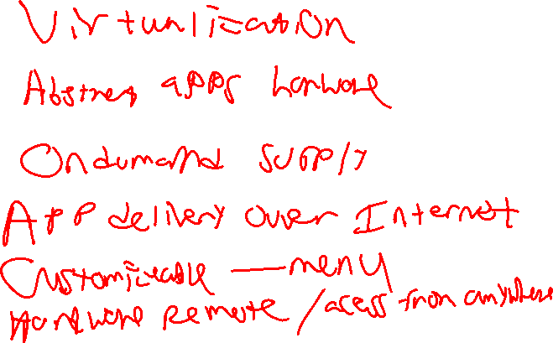
What is Cloud Computing?
IST346: Information Technology Management & Administration
Notes:
Virtualization
Abstratact apps hardware
On demand supply
Apply delivery over the internet
Customizable menu or items
Remote access from anywhere

Slide 3
What is Cloud Computing?
It is a “marketing term” – not a “technical term”
What is it?

Slide 4
Defined Cloud Computing:
Cloud computing is a model for enabling ubiquitous, convenient, on-demand network access to a shared pool of configurable computing resources (e.g., servers, storage, databases, networking, software, analytics, and intelligence)

Slide 5
It is: Computing over the “Internet” or “network”
Amazon’s idea was the Internet was the OS.
Announcing Amazon Elastic Compute Cloud (Amazon EC2) - beta
Notes:
It is designed to make web-scale computing easier for developers. Just as Amazon Simple Storage Service (Amazon S3) enables storage in the cloud, Amazon EC2 enables “compute” in the cloud. Amazon EC2’s simple web service interface allows you to obtain and configure capacity with minimal friction. It provides you with complete control of your computing resources and lets you run on Amazon’s proven computing environment. Amazon EC2 reduces the time required to obtain and boot new server instances to minutes, allowing you to quickly scale capacity, both up and down, as your computing requirements change.

Slide 6
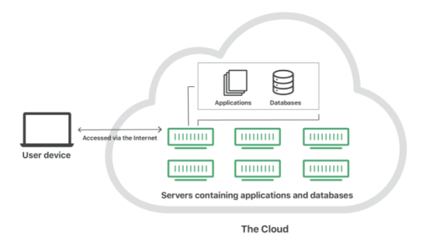

Slide 7
What is Cloud Computing?
NIST Cloud Computing Standards:
‘as a Service’
‘Pay Per Use’ Business Model
Key is “Business Model”

Slide 8
What is NIST?
NIST led development of:
NIST Cloud Computing Reference Architecture
You MUST Learn/Know it Well!
NIST Cloud & Cybersecurity standards guide global industry

Slide 9
Cloud Services Overview
Typically utilizes Virtualization or Containers to keep costs down while offering a larger number of services.
Shared resource model helps make the best use of hardware.
Providers have varying chargeback models to customers:
By amount of data stored (per mb/gb/tb)
By bandwidth used (mb/hr, gb/week, gb/month, etc..)
By resources used (ram, cpu)
By number of users accessing the service
Or combinations of all of the above.

Slide 10
Benefits of Cloud Services
Costs - Helps companies avoid up front costs of infrastructure
Anywhere/anytime - You can consume the service whenever and wherever you wish (provided you have an internet connection)
Management - Servers/services can be partially or fully managed by the cloud provider
Network - Cloud computing can deliver increased bandwidth
Economies of Scale - Cloud providers take advantage of the sharing of redundant resources to reduce costs and increase scale.
Scalability - In addition it is easy to scale cloud services because providers have already invested in infrastructure.
Deployment - quick deployment compared to in house solutions.
Backup – Backup and recovery are sped up and simplified since the data resides at the cloud provider.

Slide 11
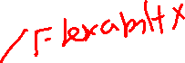
Drawbacks to Cloud Services
Big data - Not easy to move huge datasets in and out of the cloud.
Control - Reduced control for customers who want or need it.
Integration - The silo effect exists; when you have multiple cloud services hosting your data, integration across them and with your own network can be daunting (if possible at all).
Security – how do you know your data is safe?
Costs - Increased long term costs over in house solutions.
Customization - Can reduce flexibility of services offered
Support - Places reliance on cloud provider to fix issues
Features – often features are not on par with in house solutions
Regulatory Compliance – some industries are not permitted to store data off premises.

Slide 12
Cloud Service Models

Slide 13
Cloud Services on the Internet
Cloud computing is an extension of the service model to the ubiquities of the internet. Don’t want to deal with datacenters or servers? Try Infrastructure as a Service!
Don’t want to bother with the infrastructure and the components required by your service? Try Platform as a Service!
Heck, don’t want to bother with any of it? Then Software as a Service is for you!

Slide 14
Infrastructure as a Service (IAAS)
The most basic cloud-service model
Provides you with virtual infrastructure, for example servers and data storage space.
Virtualization plays a major role in this mode, by allowing IaaS-cloud providers to supply resources on-demand extracting them from their large pools installed in data centers.
High level of flexibility, but requires greater IT skillsets.
Sales Pitch: “Let us handle your hardware (as virtual machines). You handle the rest”
Examples: Amazon EC2, Azure, Alibaba

Slide 15
Platform as a Service (PAAS)
Cloud providers deliver you the development environment for services where the user can develop and run in-house built applications.
These services might include an operating system, a programming language execution environment, databases and web servers.
Still offers shops flexibility to develop and customize their applications, but requires less of a skillset than IAAS as they no longer need to know how to setup and manage the infrastructure and Operating Systems.
Containers in the cloud are an example of PaaS
Server Process is still running even when no work being done.
Sales Pitch: “We give you a setup so you can install or build your own app. No need to worry about the system administration.”
Examples: Google App Engine, Heroku, Microsoft Azure App Service

Slide 16
Software as a Service (SAAS)
Provides you with access to already developed applications that are running in the cloud.
The access is achieved by cloud clients and the cloud users do not manage the infrastructure where the application resides, eliminating with this the way the need to install and run the application on the cloud user’s own computers.
This is method requires the least amount of IT skillsets in house, but also reduces or eliminates flexibility and control over how the service should function.
Sales Pitch: “We give you the apps, all you need to do is your job!”
Examples: Salesforce.com, Office 365, Google Apps, Quickbooks Pro online, Draw.io

Slide 17
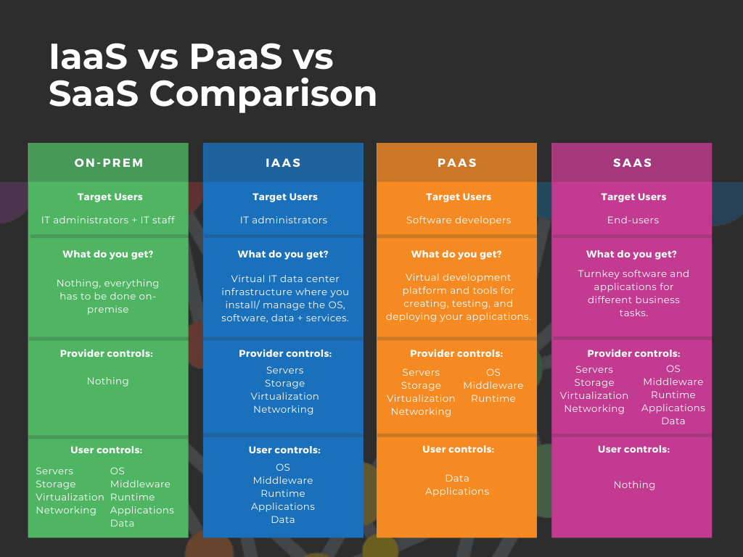
Cloud Service Models Comparison

Slide 18
Functions as a Service / Serverless computing.
Run your code in the cloud without the worry of managing IaaS or even PaaS / Containers
Ideal for microservices architectures
No Server process running when not doing work, may take longer to get first response. Only pay for execution time.
Alexa Skills, ETL processes
Examples: AWS Lambda, OpenFaaS, Google Cloud Functions

Slide 19
DaaS – Desktop as a Service
Cloud-based VDI (Virtual desktop infrastructure)
The DaaS provider typically takes full responsibility for hosting and maintaining the computer, storage, and access infrastructure, as well as applications and application software licenses needed to provide the desktop service in return for a fixed monthly fee.
Examples: Mac-In-Cloud, Azure Virtual Desktop, VMWare Workspaces

Slide 20
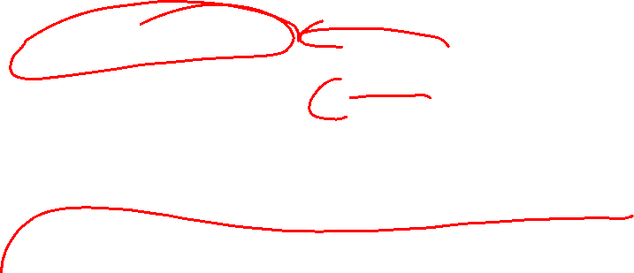
Three Main Types of Cloud Service
Markets (Deployment Models)
Public Cloud
Private Cloud
Hybrid Cloud ( = Public + Private)

Slide 21
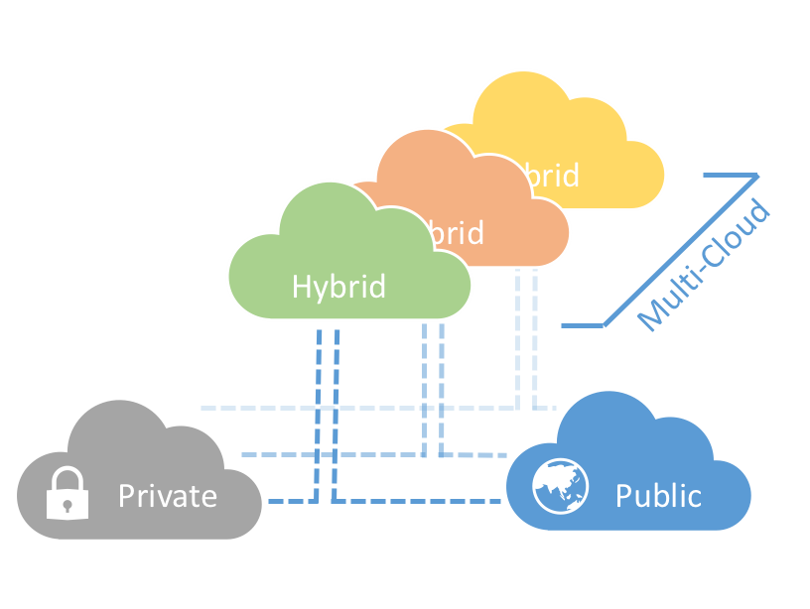
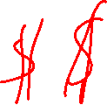

Slide 22
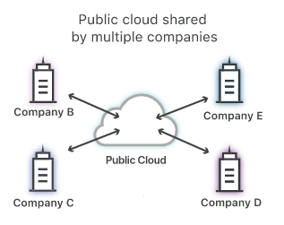
Public Cloud

Slide 23
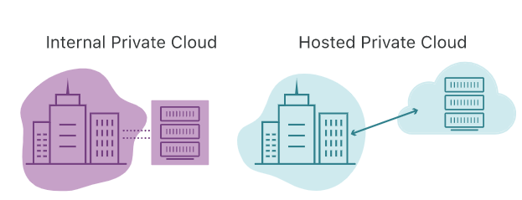
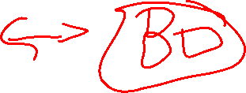
Private Clouds
2 Types
On-Site Private
Hosted Private (Outsourced)

Slide 24
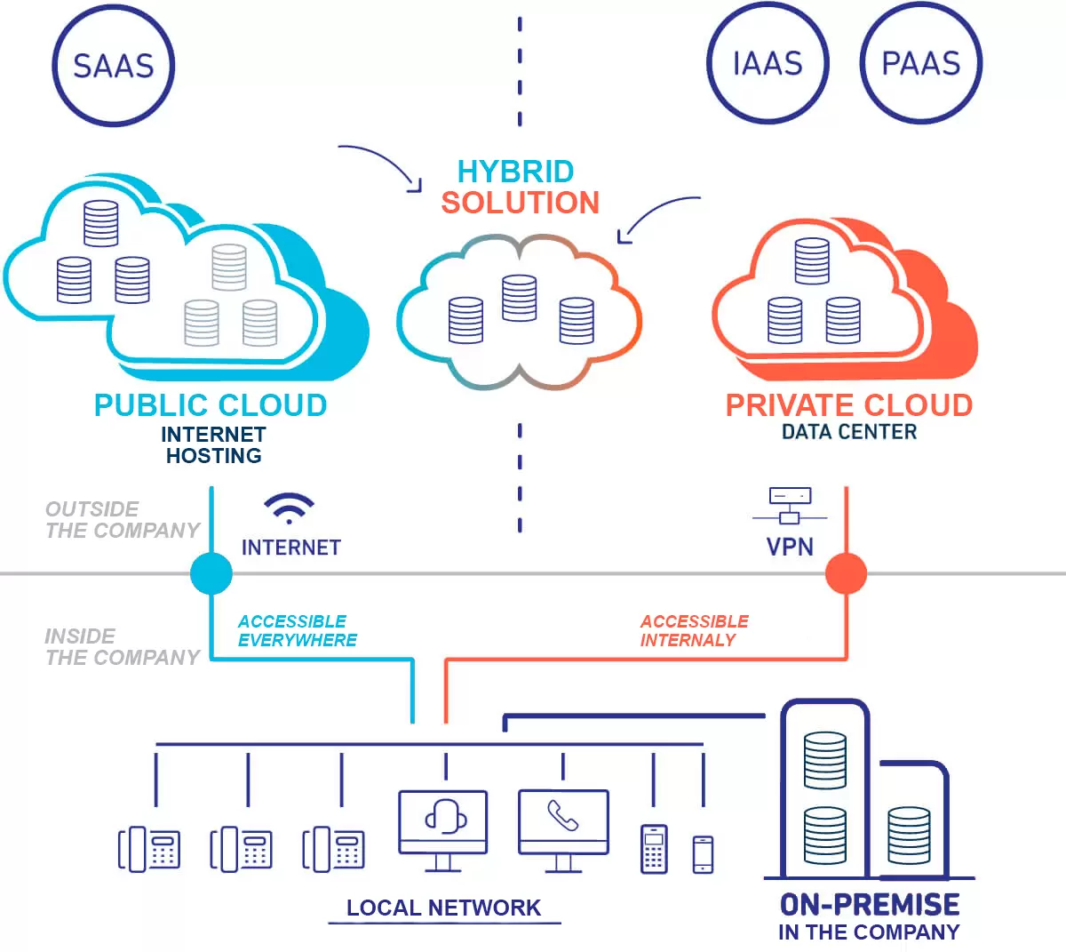
Hybrid Clouds

Slide 25
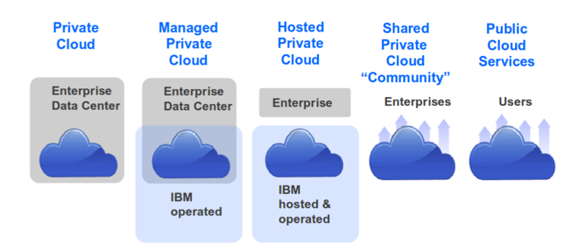

Different Deployment Models

Slide 26
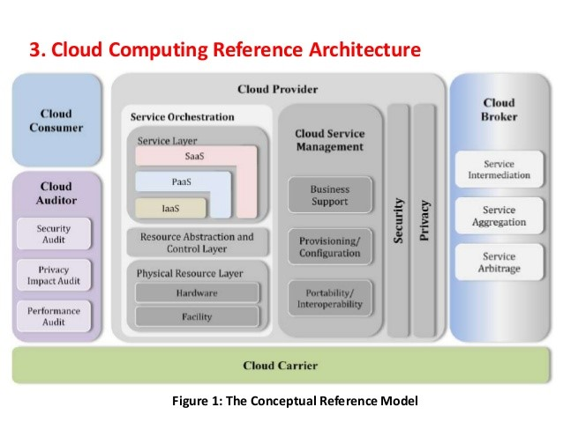
NIST Cloud Computing Model

Slide 27
SU’s Clouds
Over 4.85 THz CPU–1,000 GHz per THz
Your computer has 2-3 GHz processor
Over 60 TB of Memory-1,000 GB er TB
Your computer has 8-16 GB of Memory
Over 7 PB of storage

Slide 28
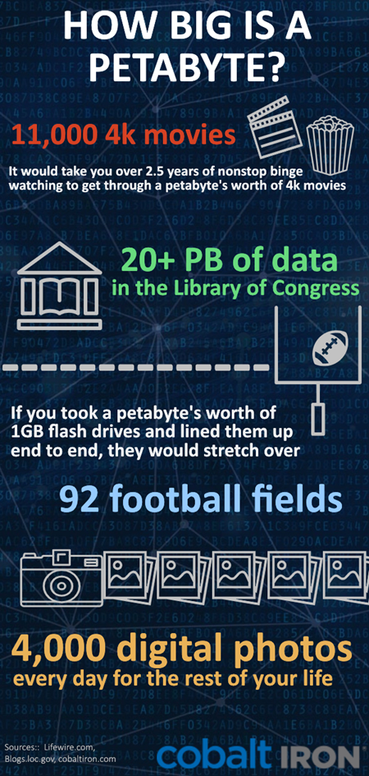
How big is a PB?

Slide 29
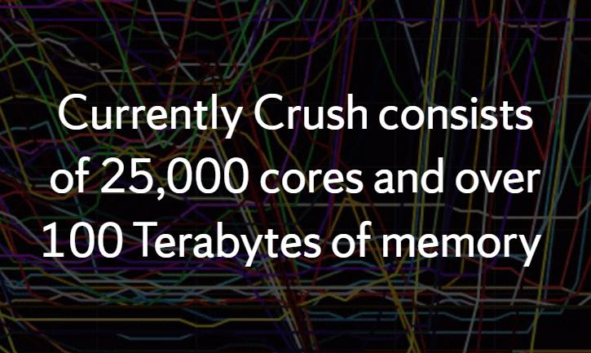
And another Cloud…
Crush: Virtualized Research Cloud - Research Computing – Syracuse University

Slide 30

Questions?
"If computers get too powerful, we can organize them into committees. That'll do them in."
IST346: Information Technology Management & Administration

